Slide 1
Customer Churn Prediction in the Banking Industry
Presented by
Sumaya Sarwar Sara Fariha Moazzema Raisa Mehadi Hasan
2013961042 1811295642 1731160042

Slide 2
Table of contents
01
02
03
04
05
06
Objectives
Methodology
Exploratory Data Analysis
Model Evaluation
Comparison of ML models
Conclusion

Slide 3

Objectives of
the project
Narrow down the reasons of churn
Examine the behavioral patterns
Enhance in features that are lacking in the industry
Implementation of derived solutions
Develop a better model to reduce churn
Execution of the best dealt model into the system

Slide 4
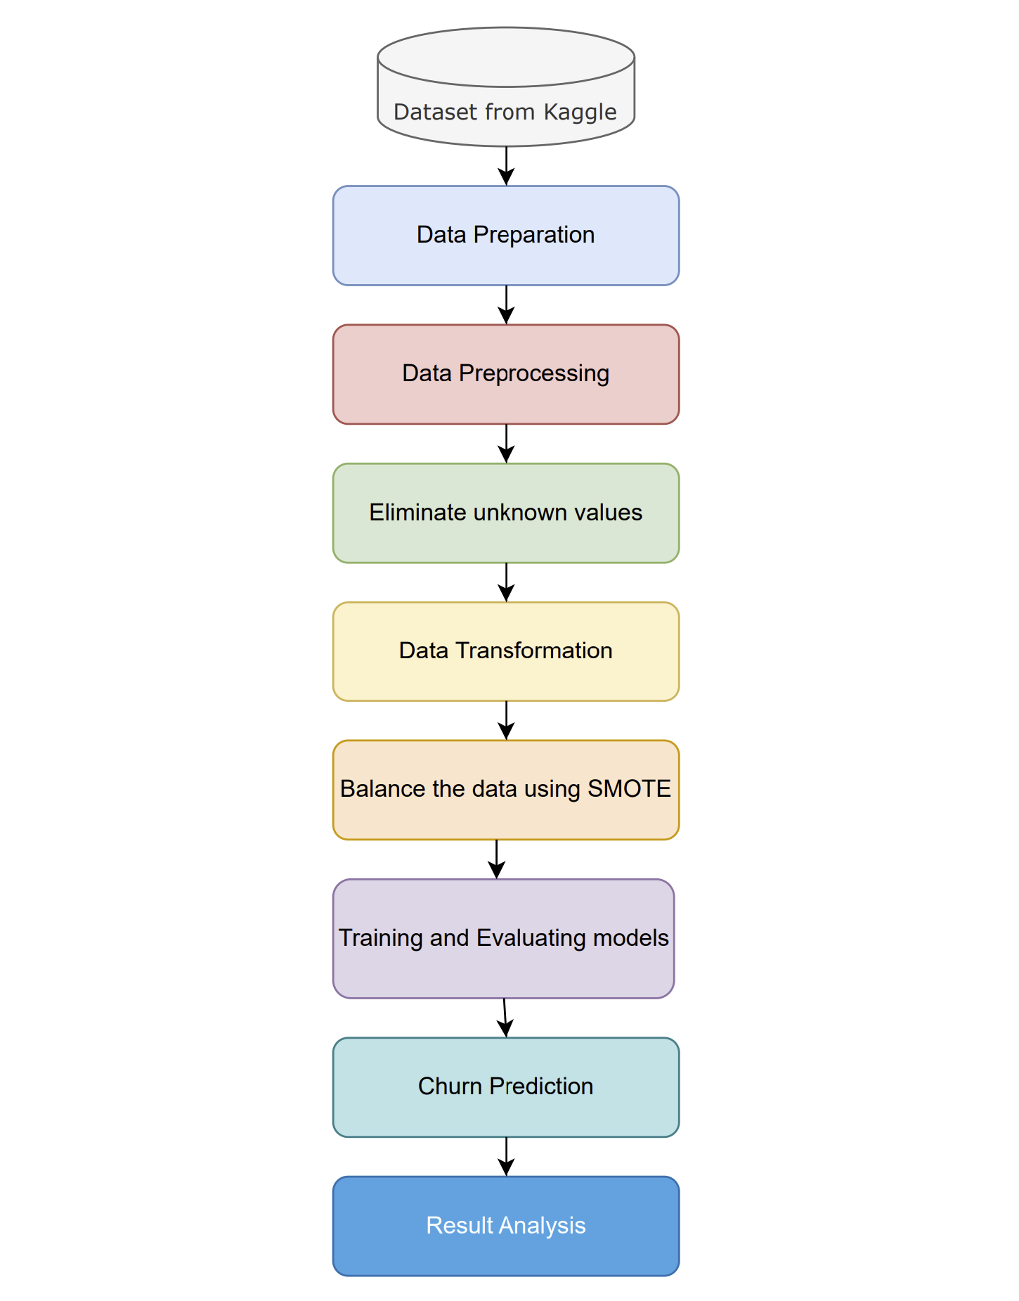
Methodology
Few ML algorithm models
Dataset
IDE for EDA
A dataset of 10,000 columns and 12 rows is chosen for the project. It is a .csv file of a bank containing all the information and features of the customers of the bank that shows the rate of churn.
The dataset is preprocessed on a coding platform or IDE such as, jupyterlab. Exploratory data analysis is carried out to help clean up the dataset and analyze it.
Few machine learning algorithm based models are tested on the dataset to measure accuracy and determine which one is the suitable most model to go with, for the execution of next step in the project.

Slide 5
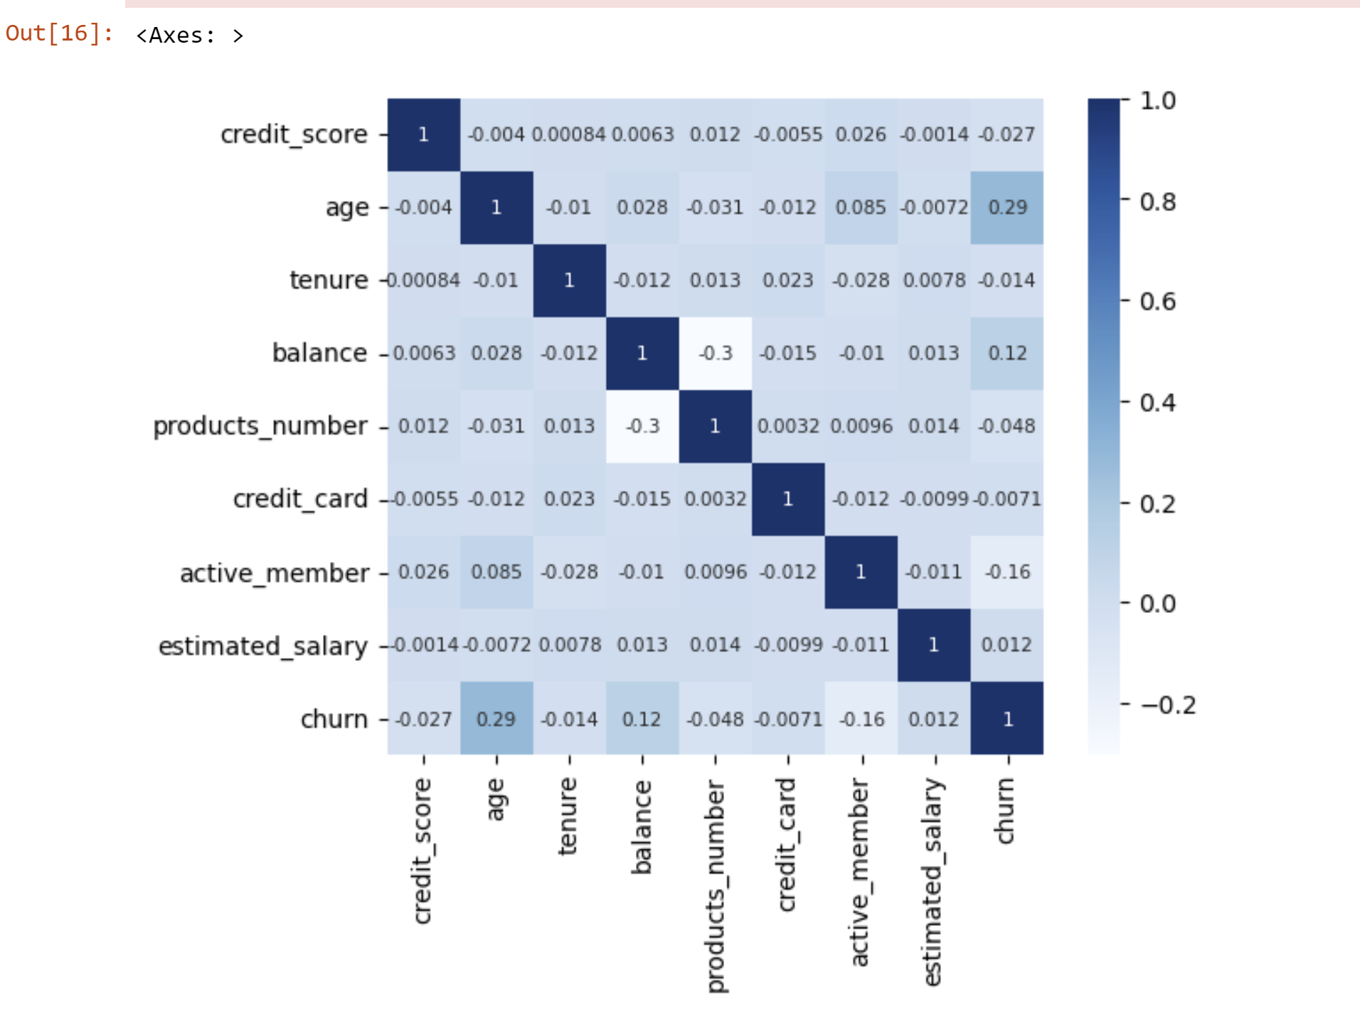
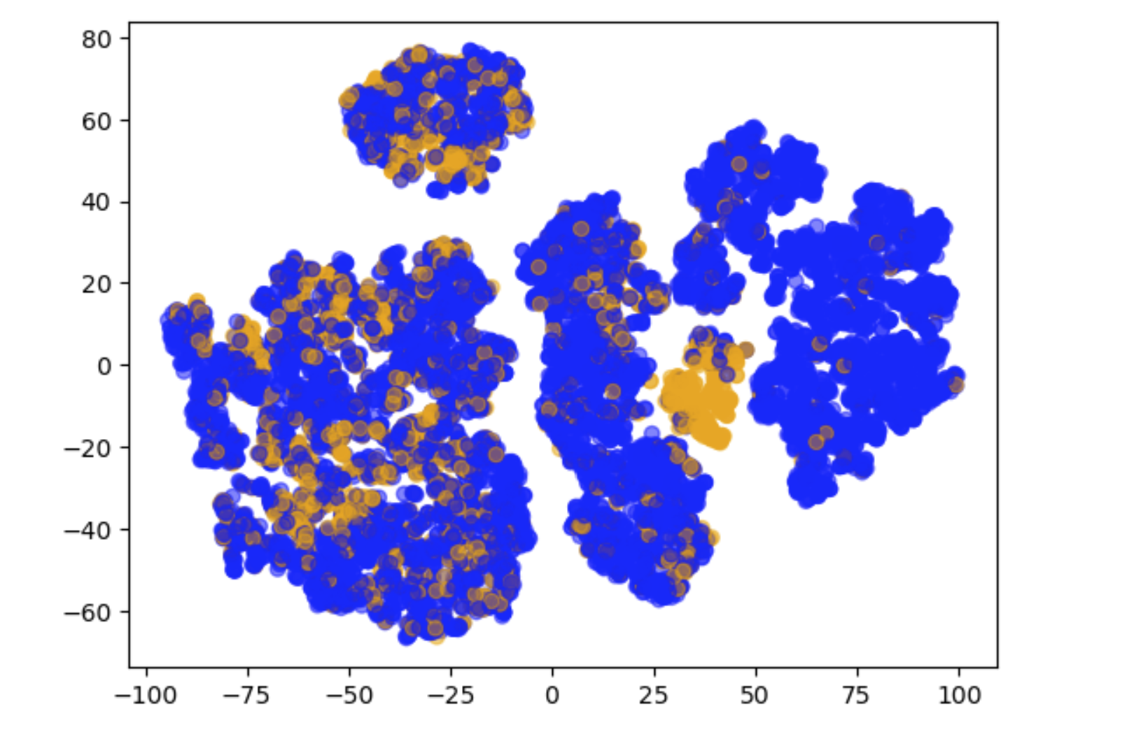
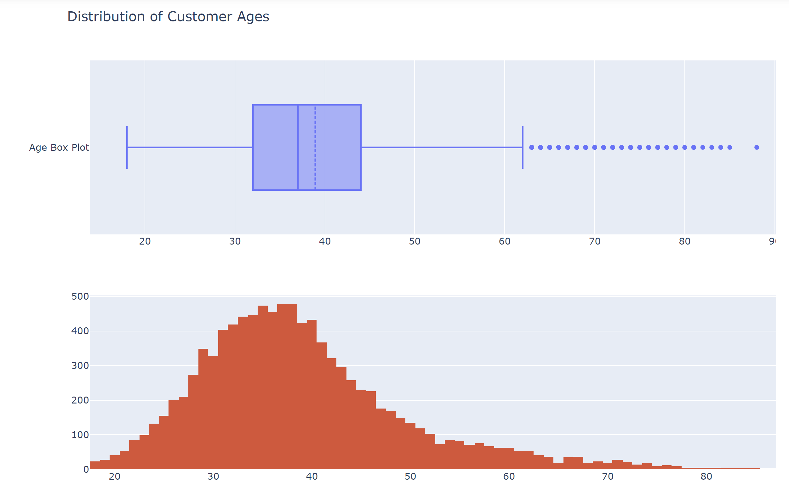
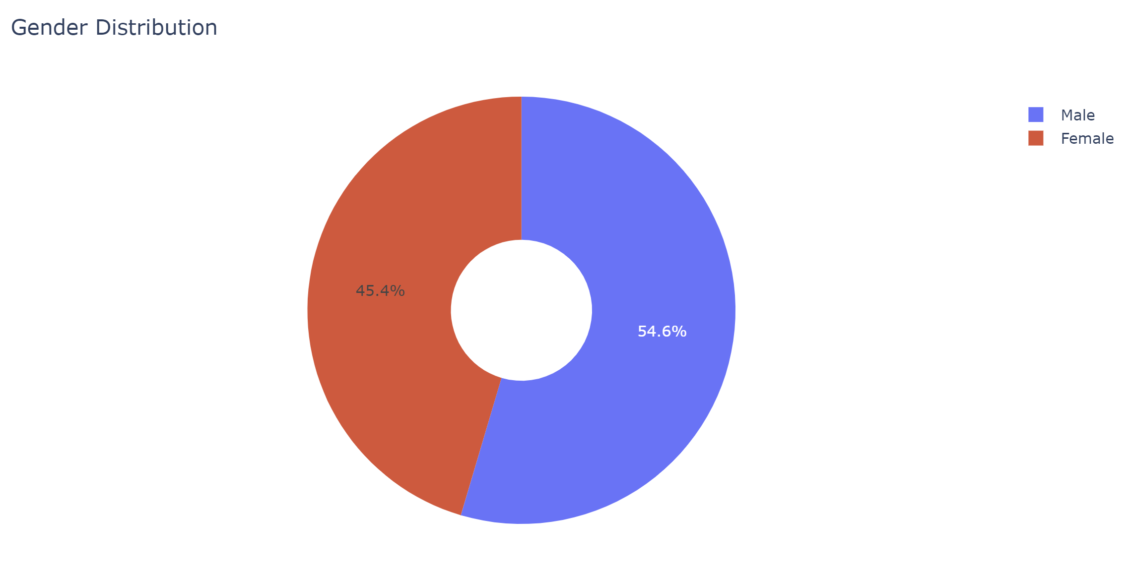
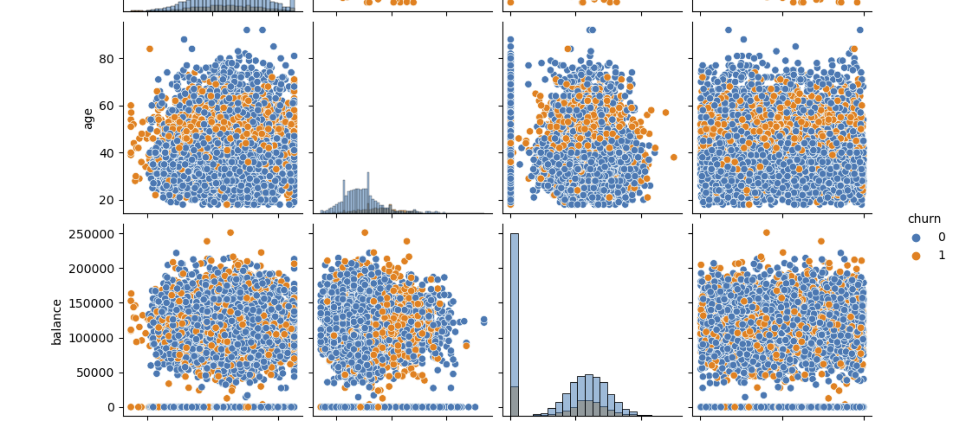
Exploratory Data Analysis
A .csv file is loaded in here to prepare the data for processing. Some of the features are dropped later. Cleanse and preprocess the collected data to handle missing values and inconsistencies. Some Heatmap, Boxplot, Histogram, Pairplot, Scatter plot are shown here.

Slide 6
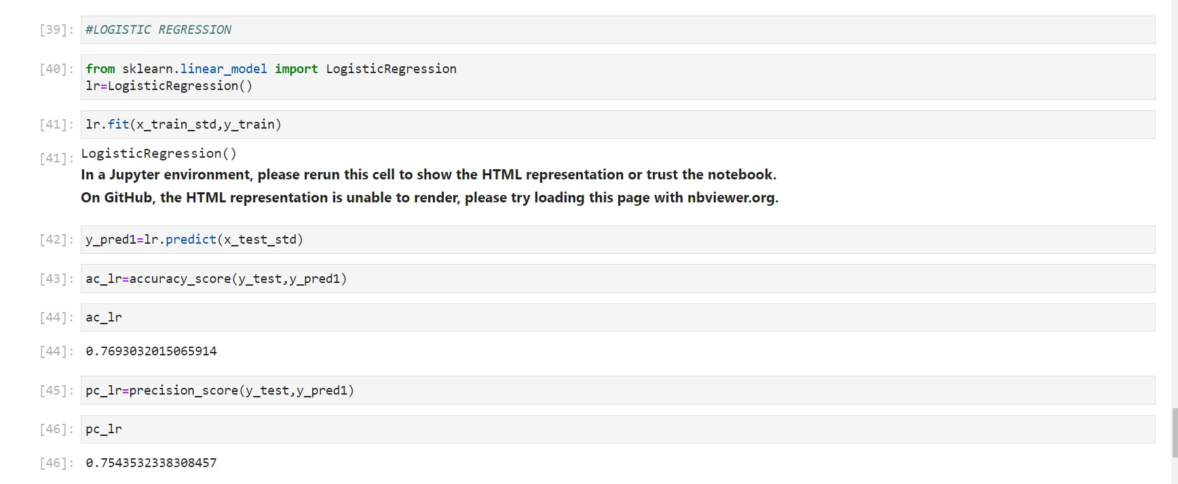
Logistic Regression
In this regard, logistic regression offers a simple yet reasonable performance.
Accuracy is 0.7543532338308457

Slide 7
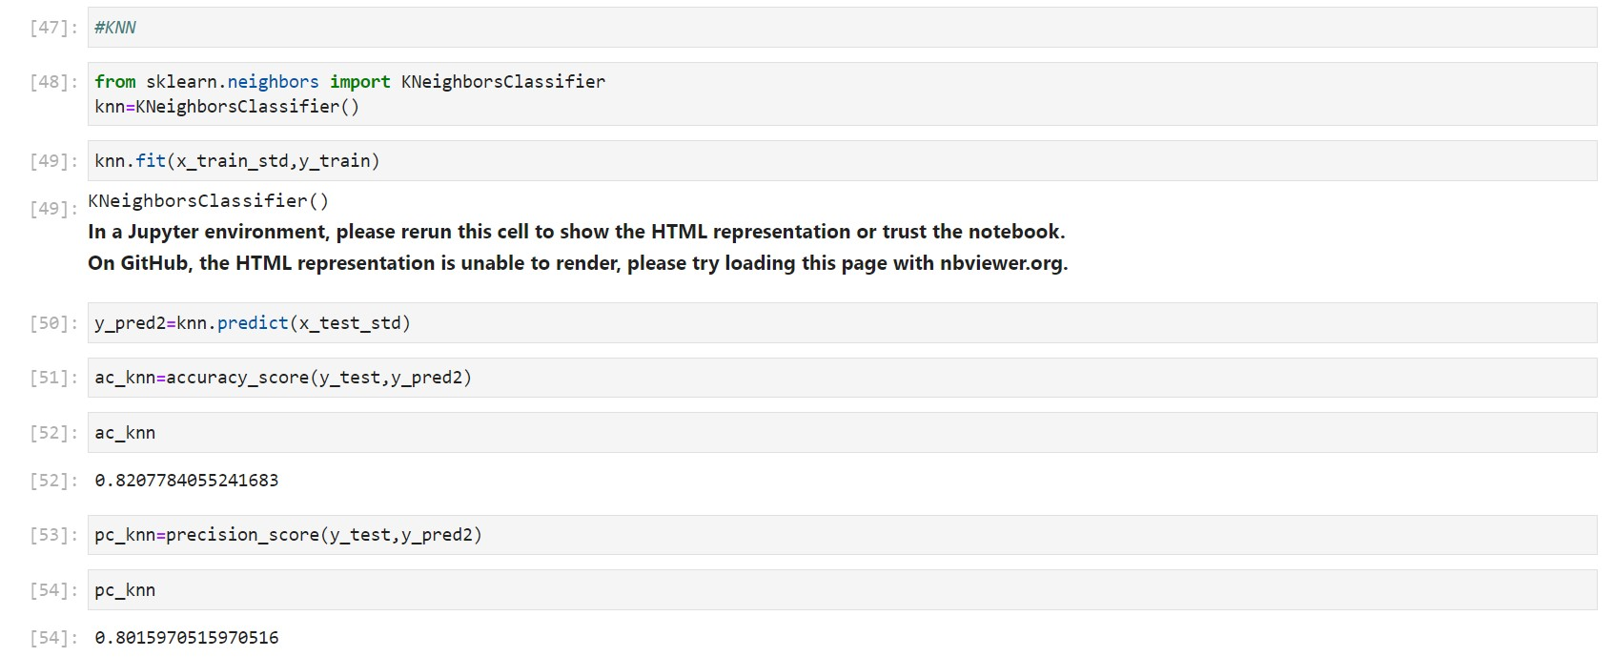
KNN
K-Nearest Neighbours achieves the maximum accuracy but with a higher level of computational complexity
Accuracy is 0.8015970515970516

Slide 8
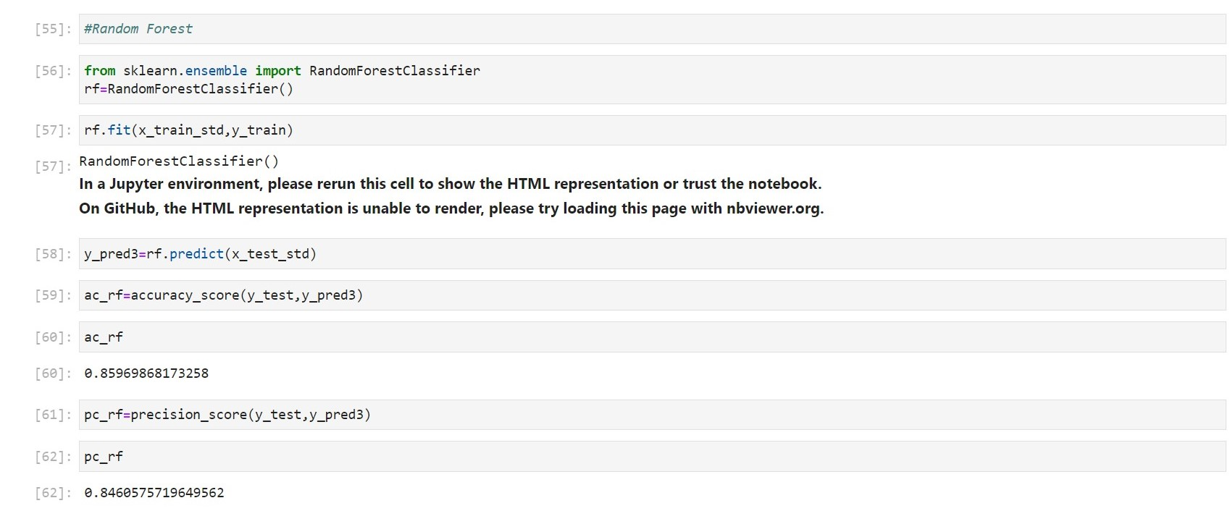
Random Forest
Random forest strikes a balance between accuracy and efficiency
Accuracy is 0.8460575719649562

Slide 9
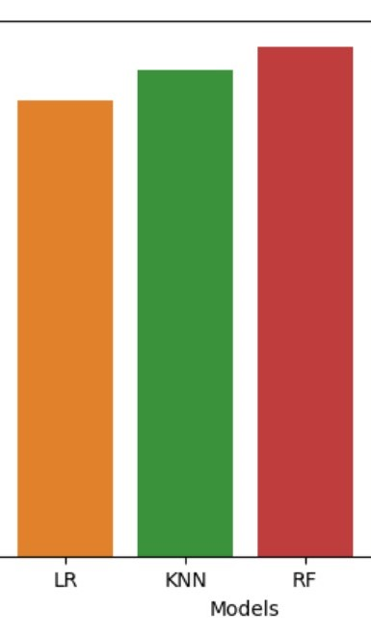
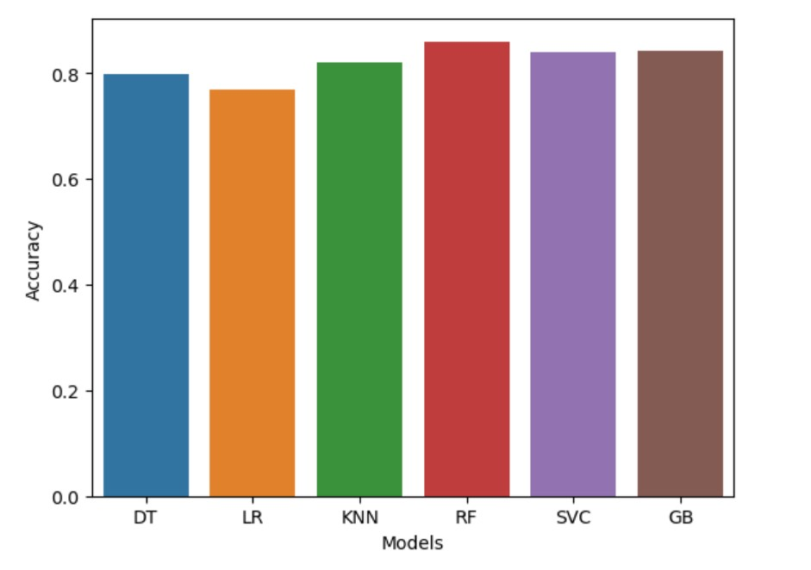
Comparison Chart
Comparison of models

Slide 10
Conclusion
Customer churn prediction using machine learning is a powerful tool that can help businesses proactively identify customers who are likely to leave their product or service. By accurately predicting churn, companies can take preventive measures to retain customers and minimize revenue loss.

Slide 11
Thanks!

